Slide 1
VLSI Project Presentation

Slide 2
Group members :
Naimul Islam Pavel
Tasdik Hossain
Mosaddek Hossain Rafi
Abdullah Al Shafe
Rajemul Islam Jehan

Slide 3
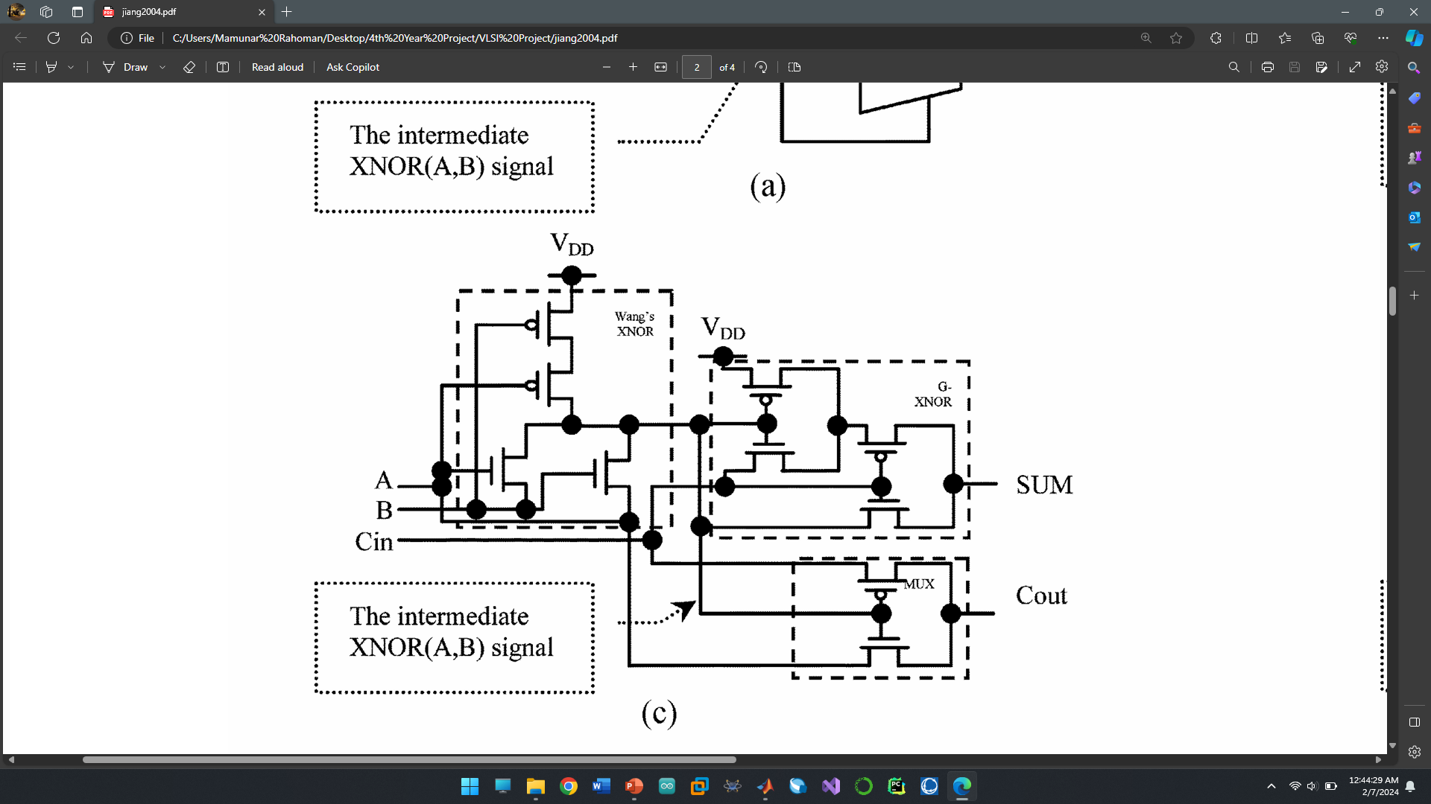
Group Member : 1
Naimul Islam Pavel
Circuit Name: Adder 10T 09A

Slide 4
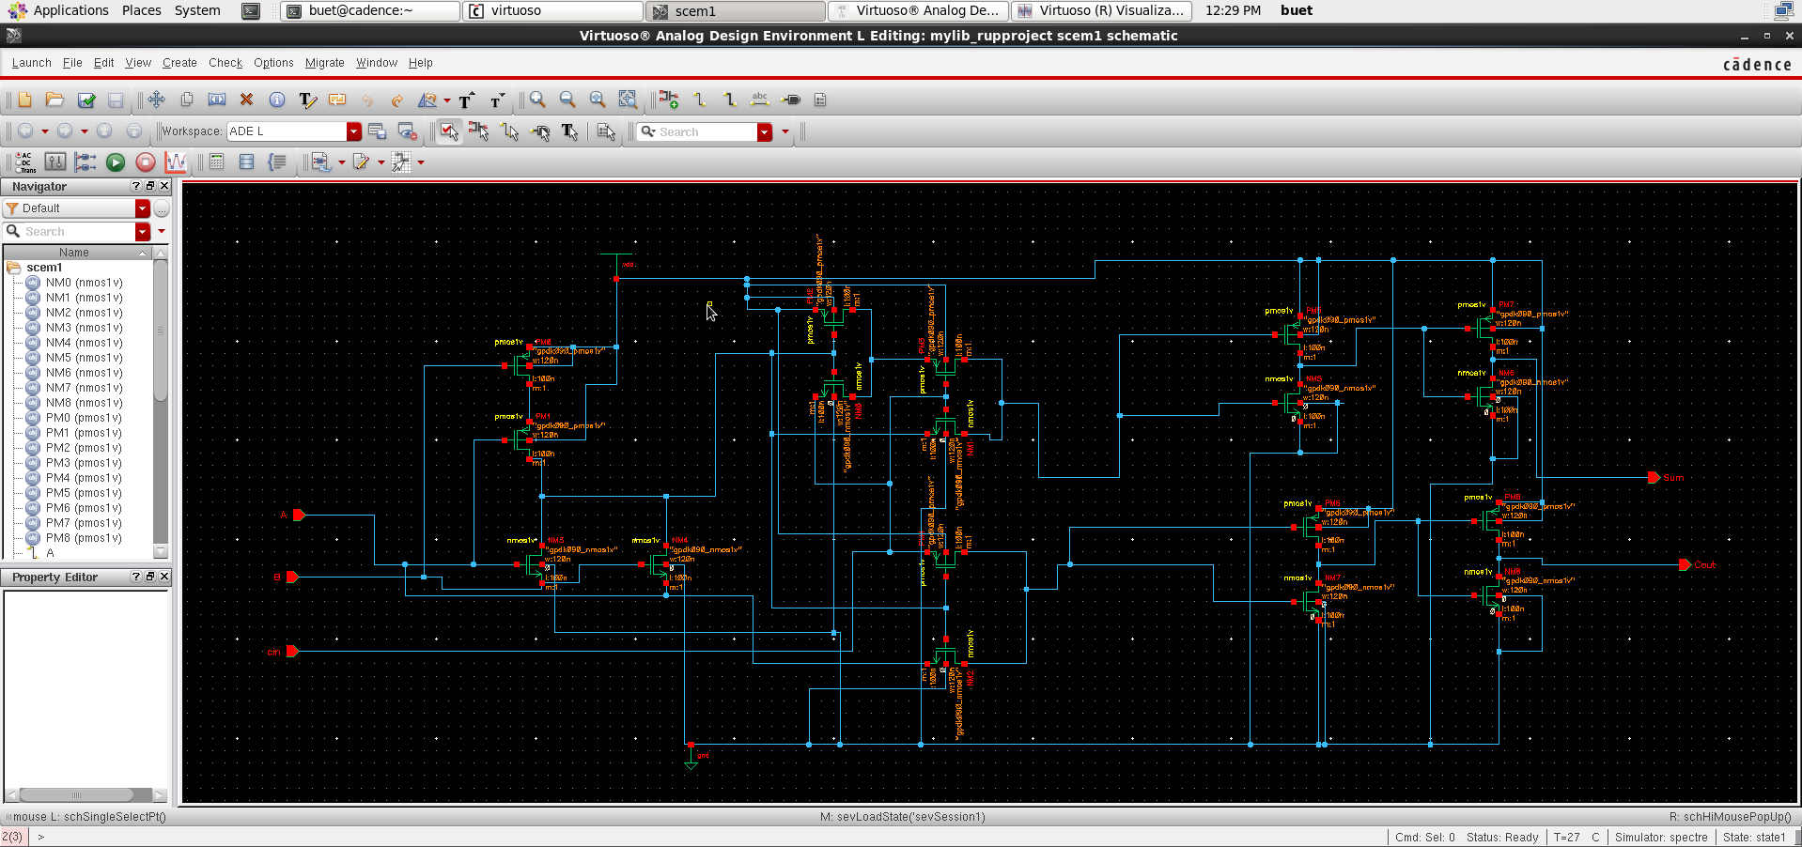
Schematic Diagram :

Slide 5
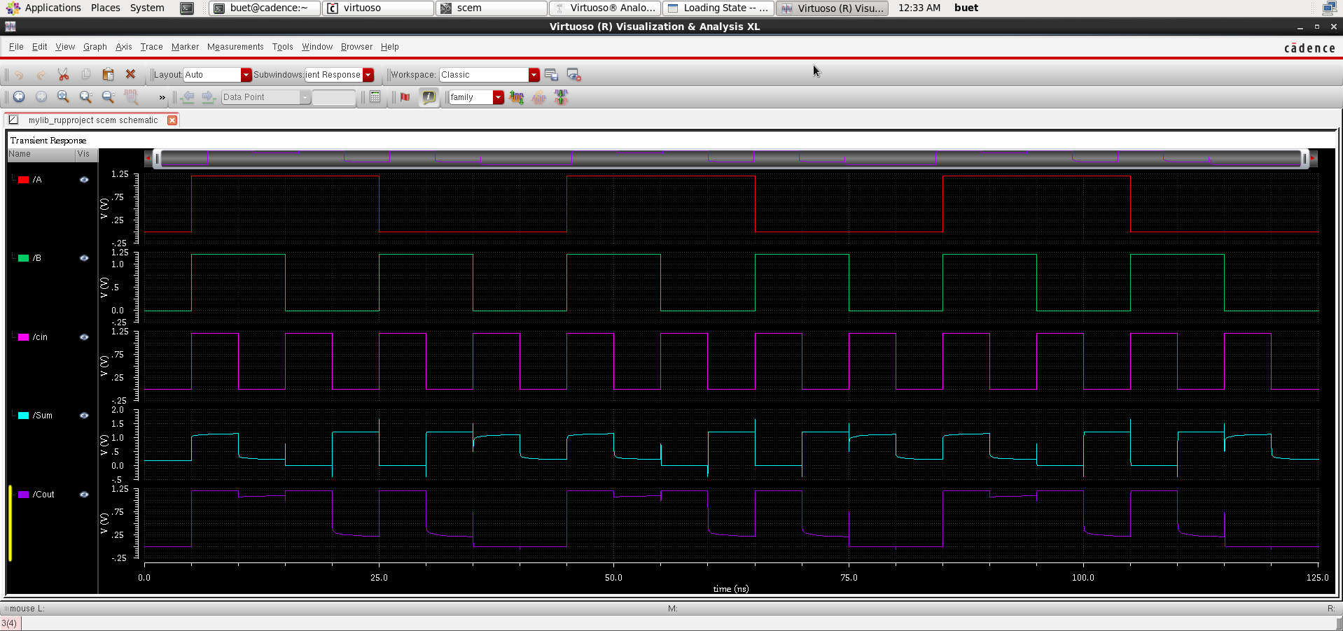
Waveform(Without Using Buffer):

Slide 6
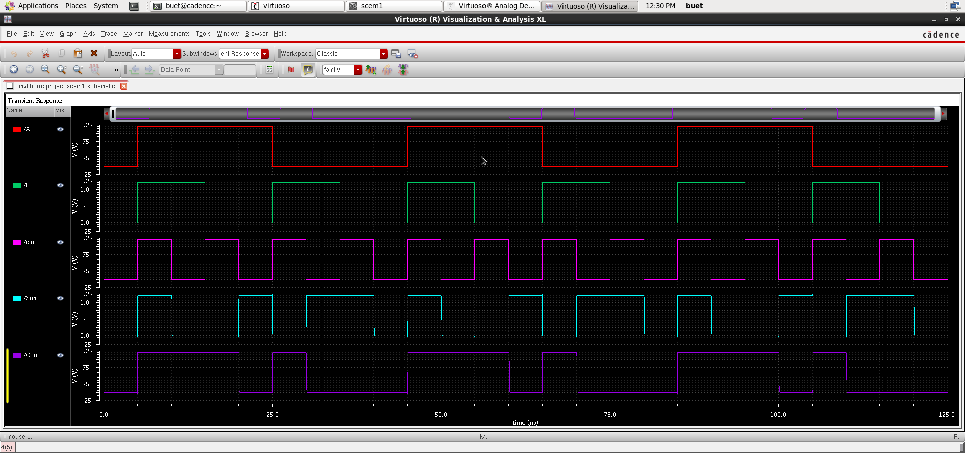
Waveform(With Using Buffer):

Slide 7
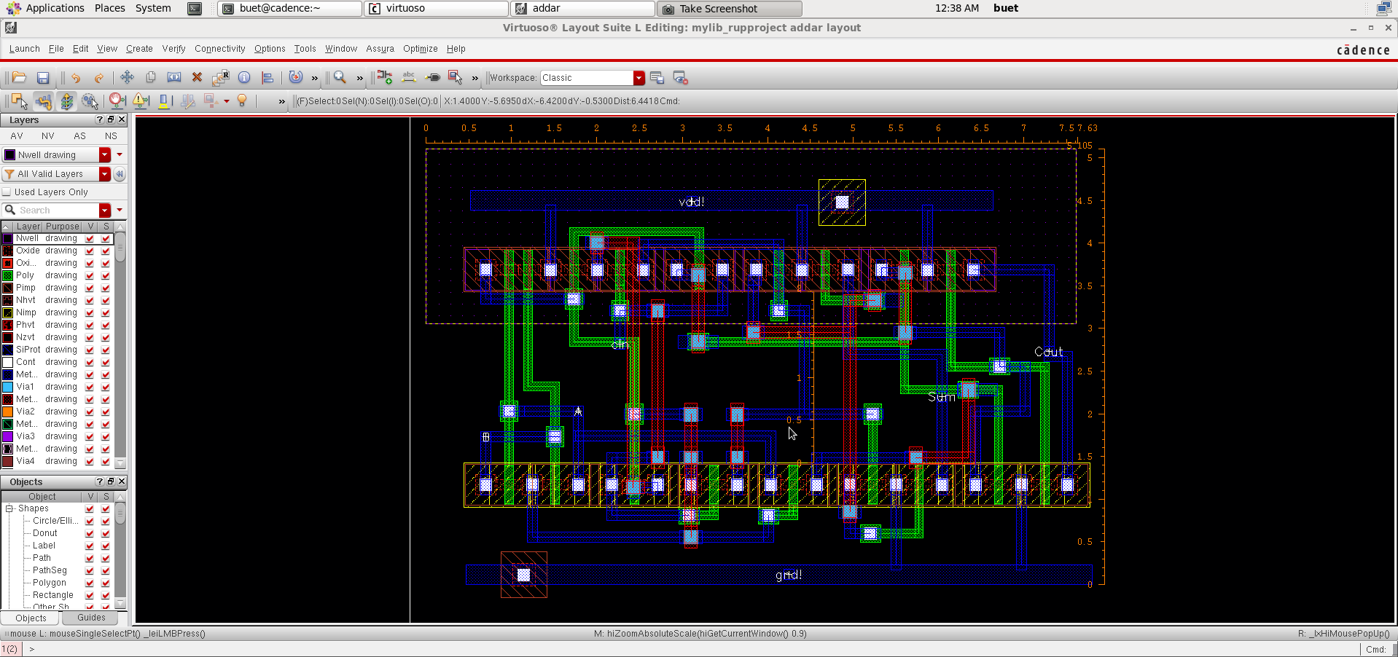
Layout Diagram:

Slide 8
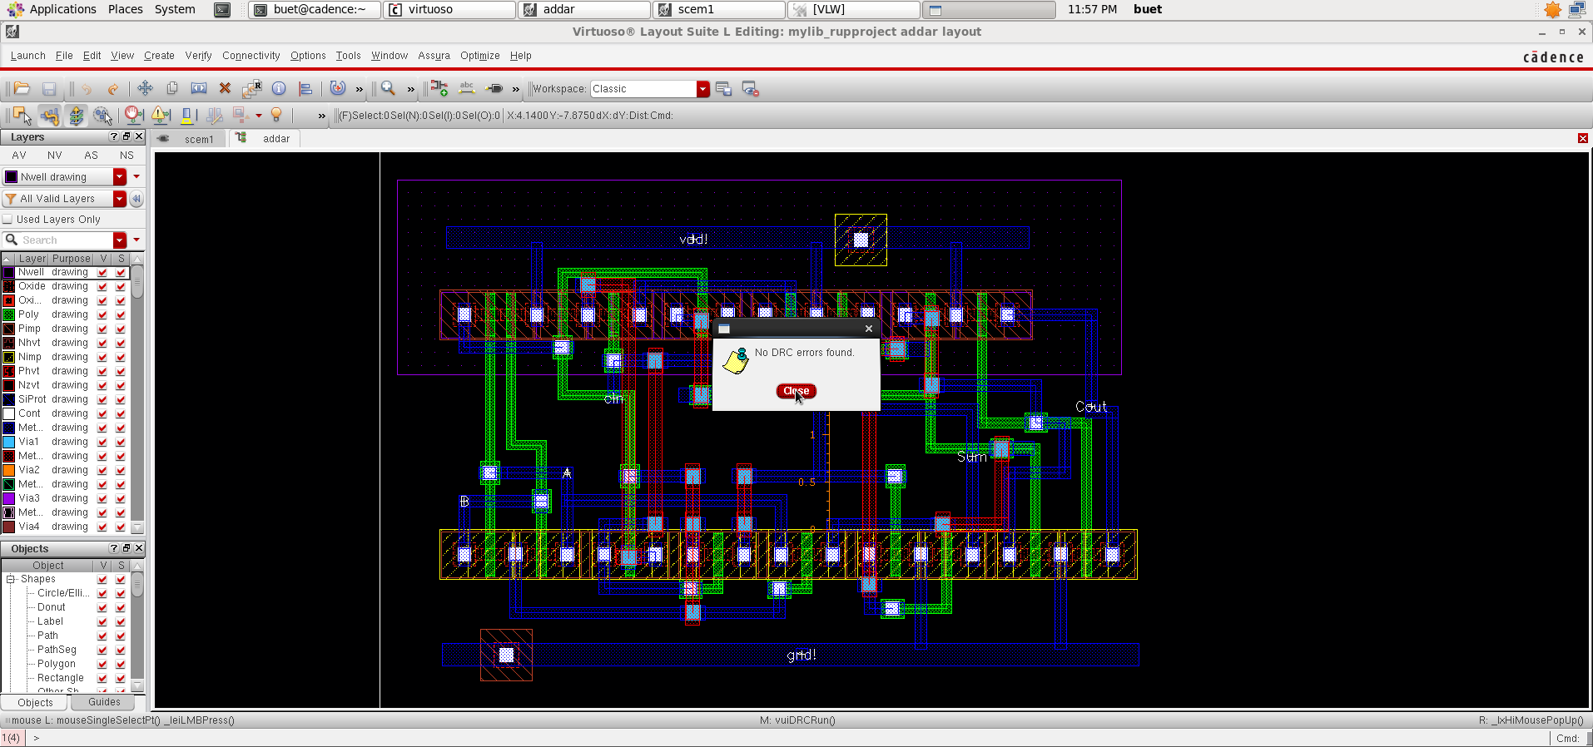
Layout Diagram(NO DRC Error):

Slide 9
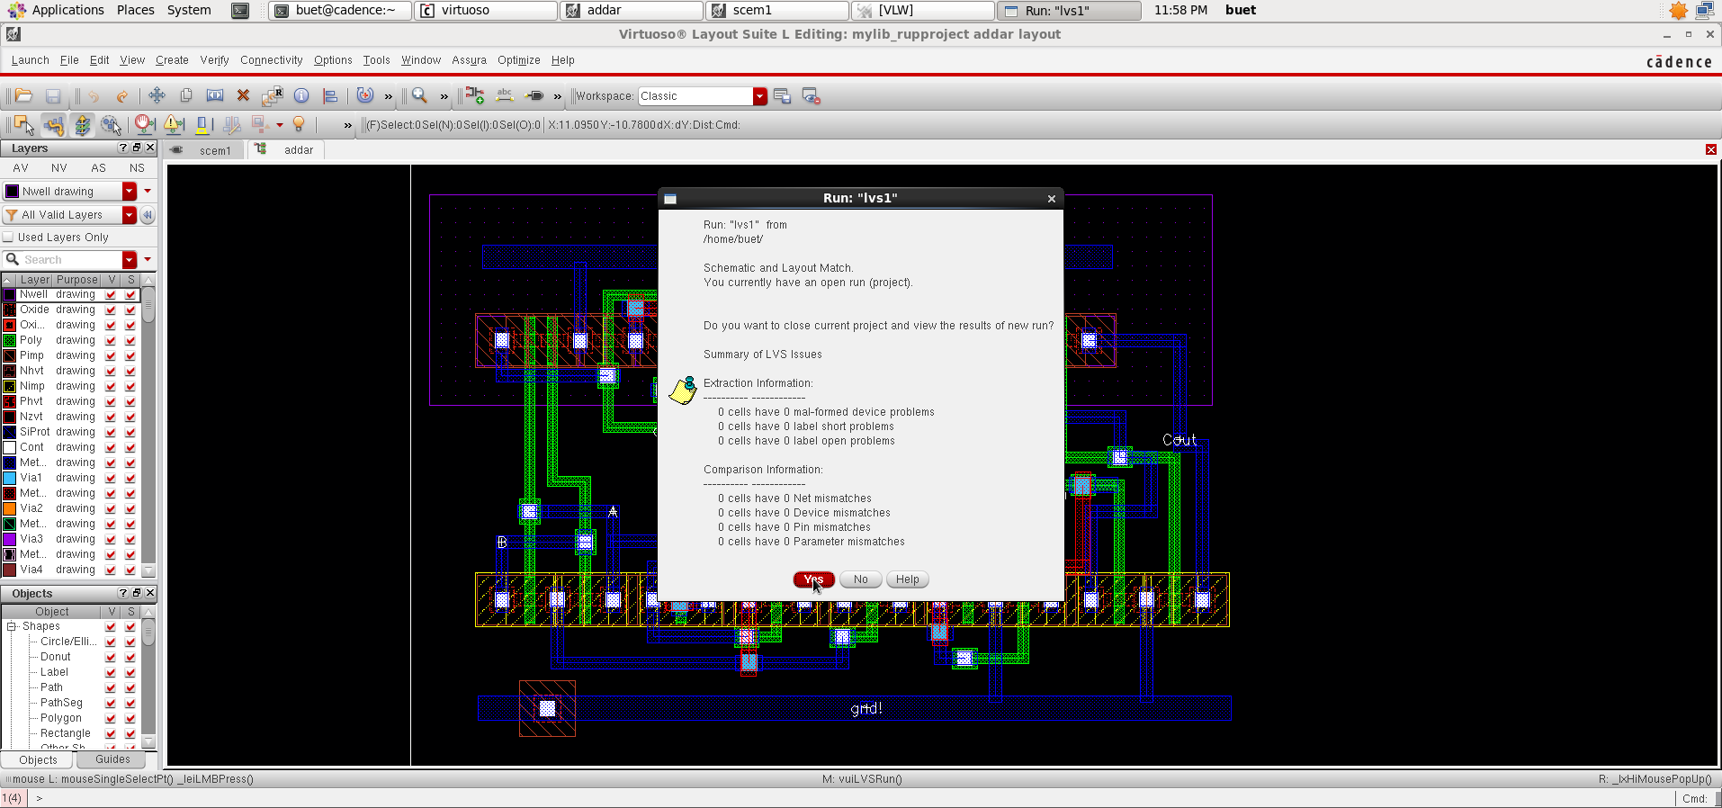
Layout Diagram(NO LVS Error):

Slide 10
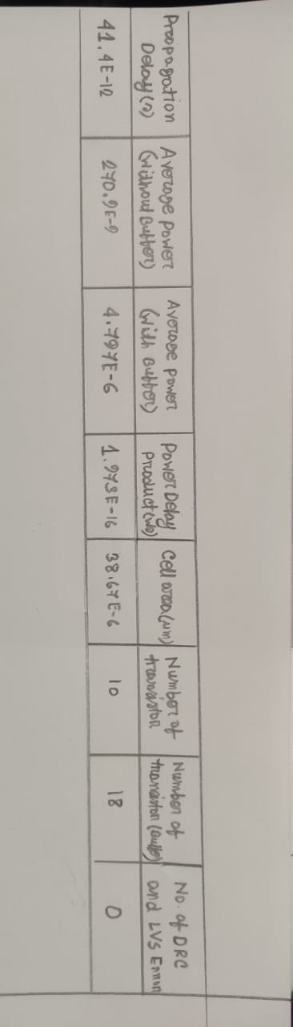
Results

Slide 11
Group Member : 2
Tasdik Hossain
1. ADDR10T13A is a 10-transistor full adder circuit designed for low-power microelectronics.
2. The main purpose of ADDR10T13A is to reduce power consumption in digital circuits.
3. Testing results have shown that ADDR10T13A offers at least a 23% power savings compared to conventional 28-transistor CMOS adders.
4. Furthermore, the ADDR10T13A adder demonstrated a speed improvement of at least 64% compared to other tested adders.
5. By utilizing fewer transistors and implementing an efficient XOR-XNOR gate, it achieves significant power savings without sacrificing speed.

Slide 12
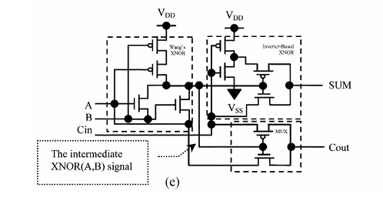
Group Member : 2
Tasdik Hossain

Slide 13
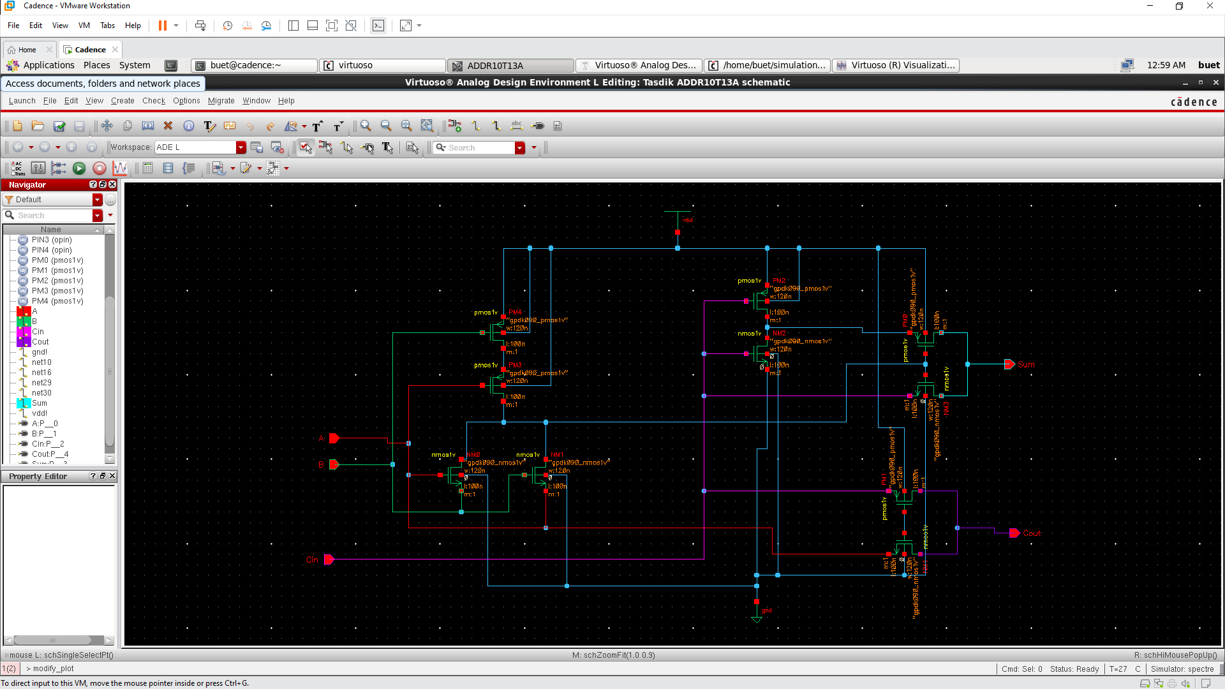
Schematic :

Slide 14
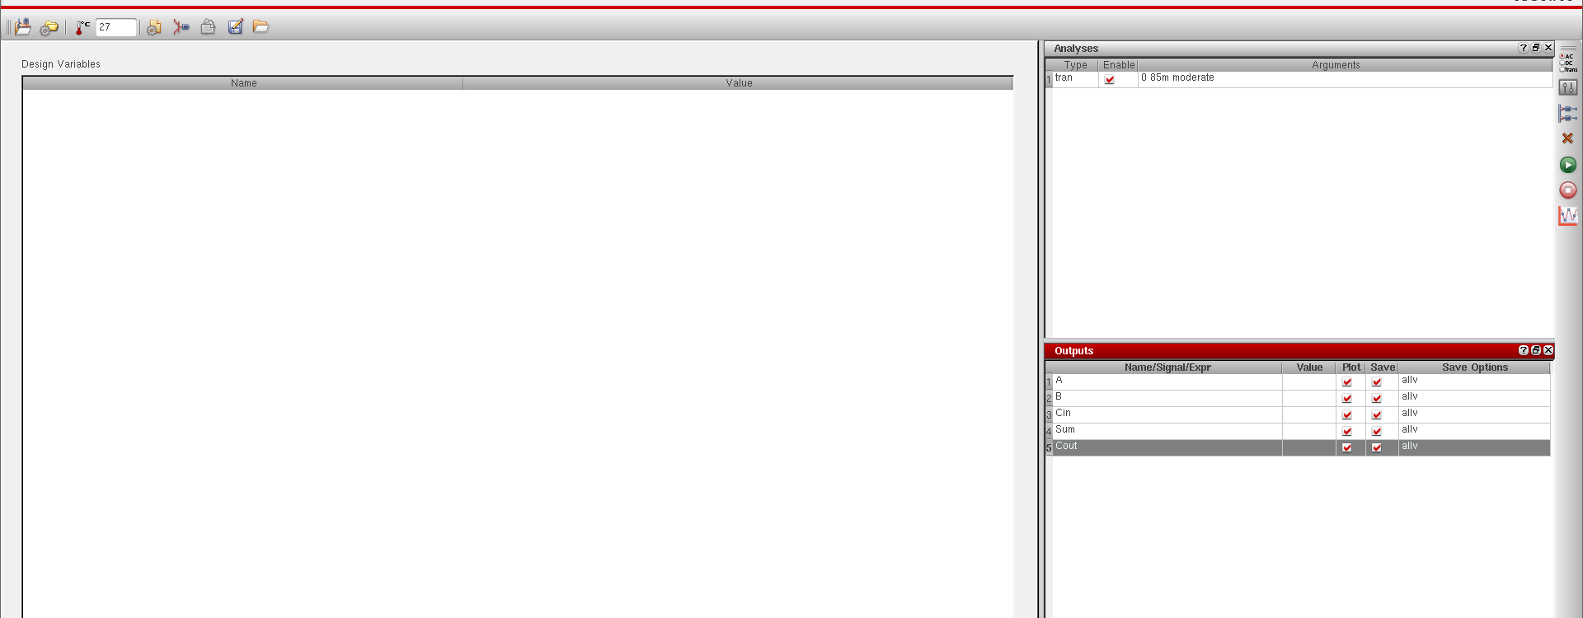
ADE L :

Slide 15
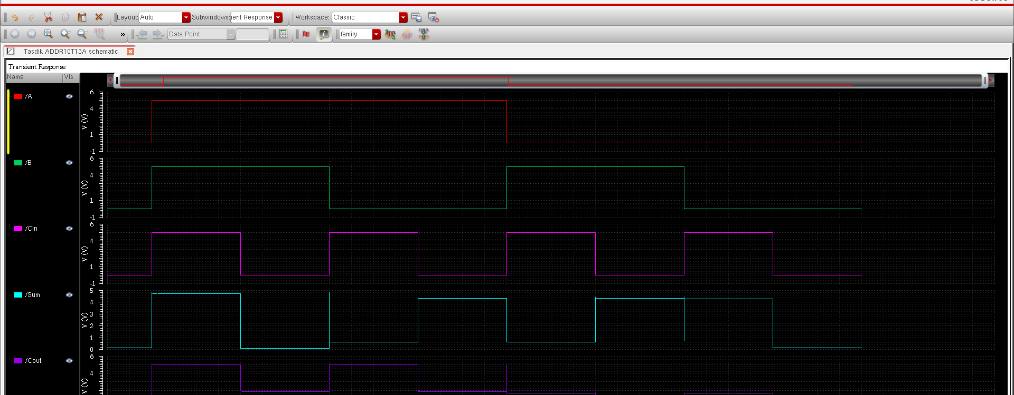
Waveshape :

Slide 16
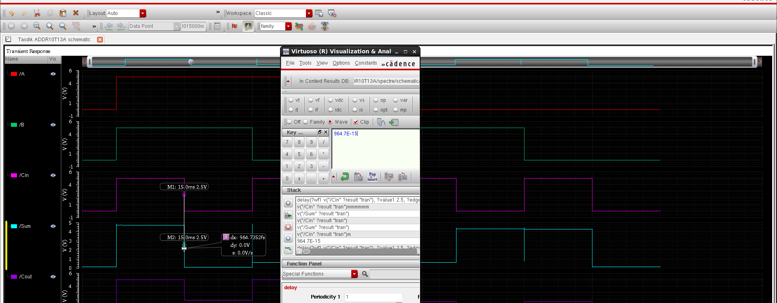
Propagation Delay :

Slide 17
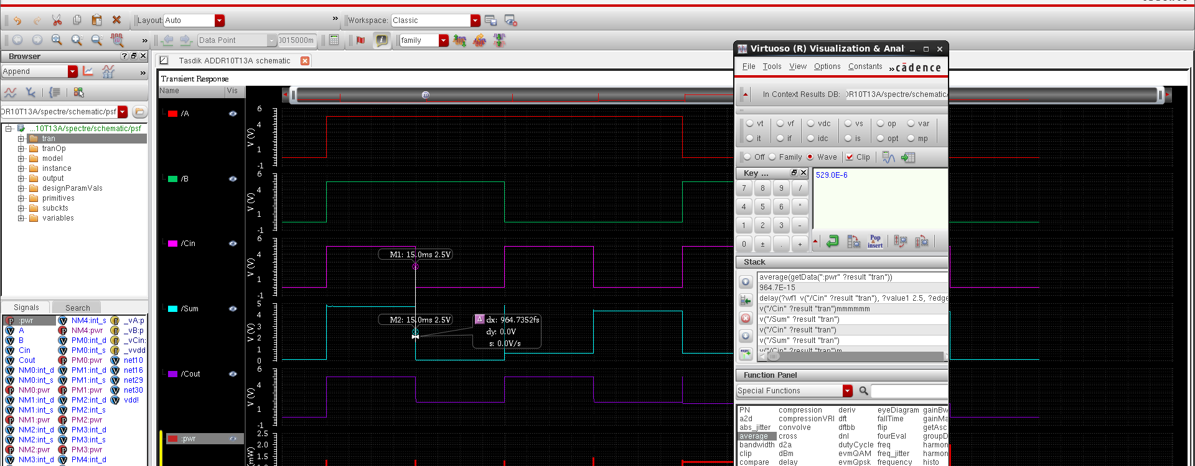
Average Power :

Slide 18
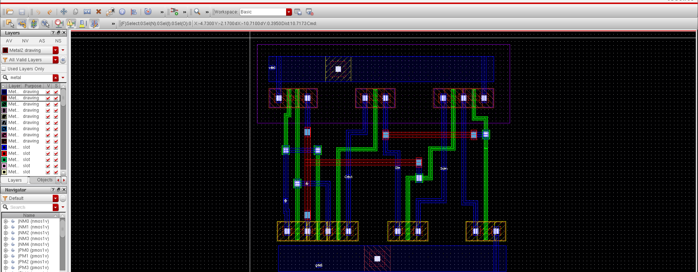
Layout :

Slide 19
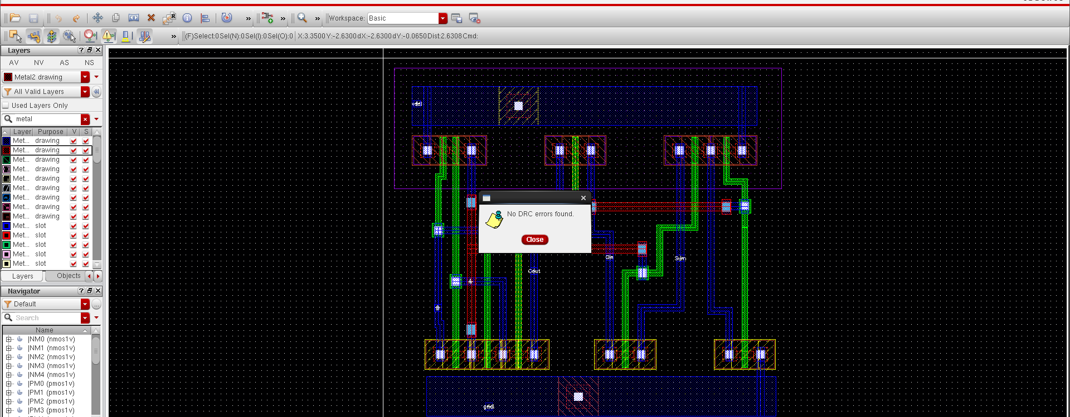
DRC :

Slide 20
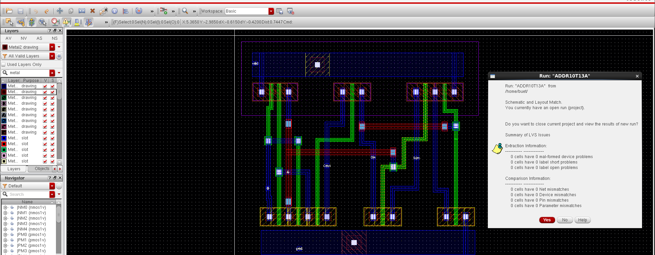
LVS :

Slide 21
Group Member : 3
Mosaddek Hossain Rafi

Slide 22
Group Member : 3
Mosaddek Hossain Rafi

Slide 23
Group Member : 3
Mosaddek Hossain Rafi

Slide 24
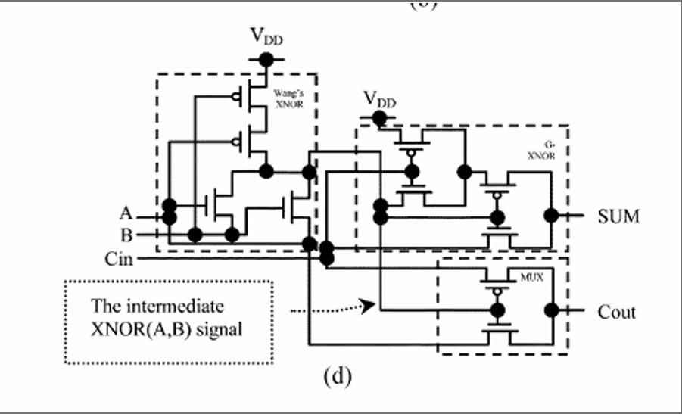
Group Member : 4
Abdullah Al Shafe
Circuit name: ADDR10T09B

Slide 25
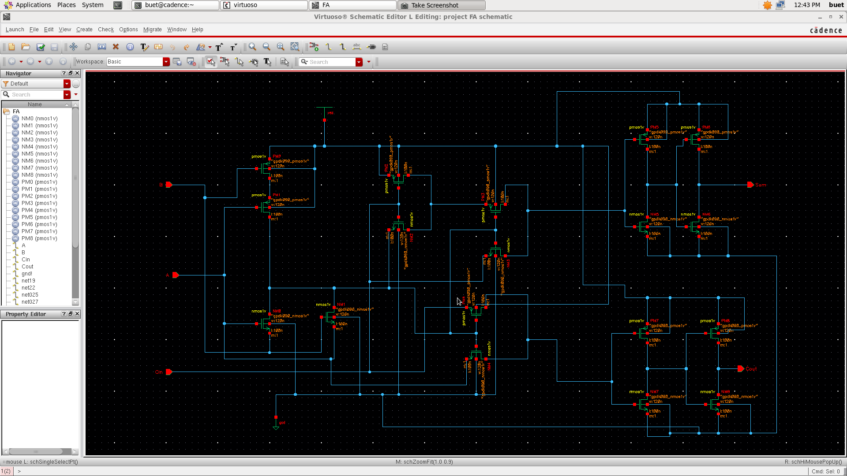
Schematic Diagram :

Slide 26
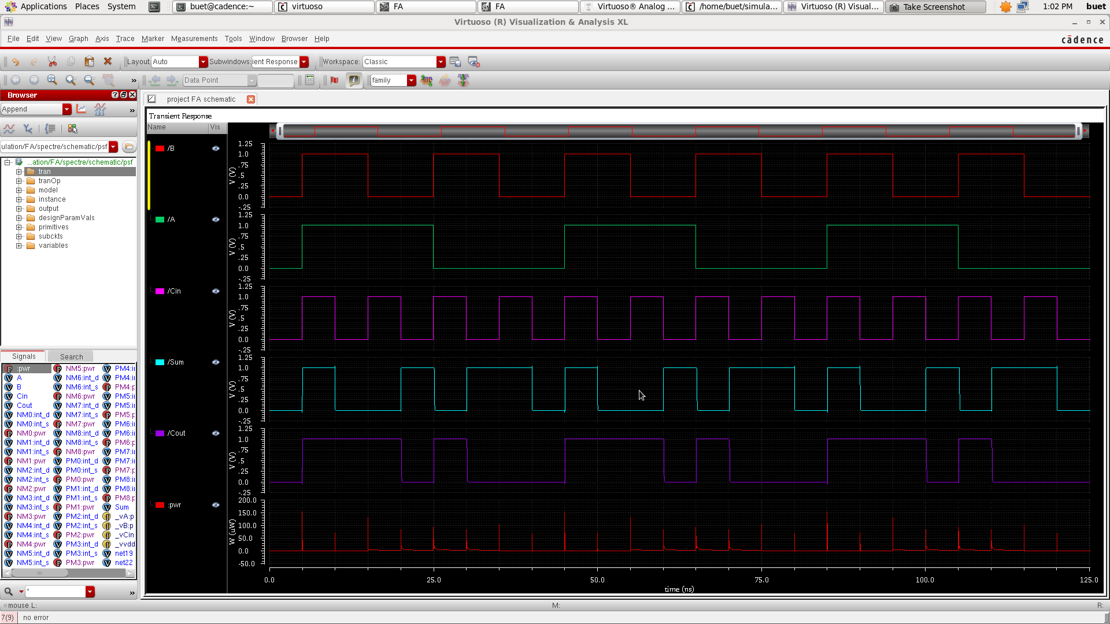
Waveshape:

Slide 27
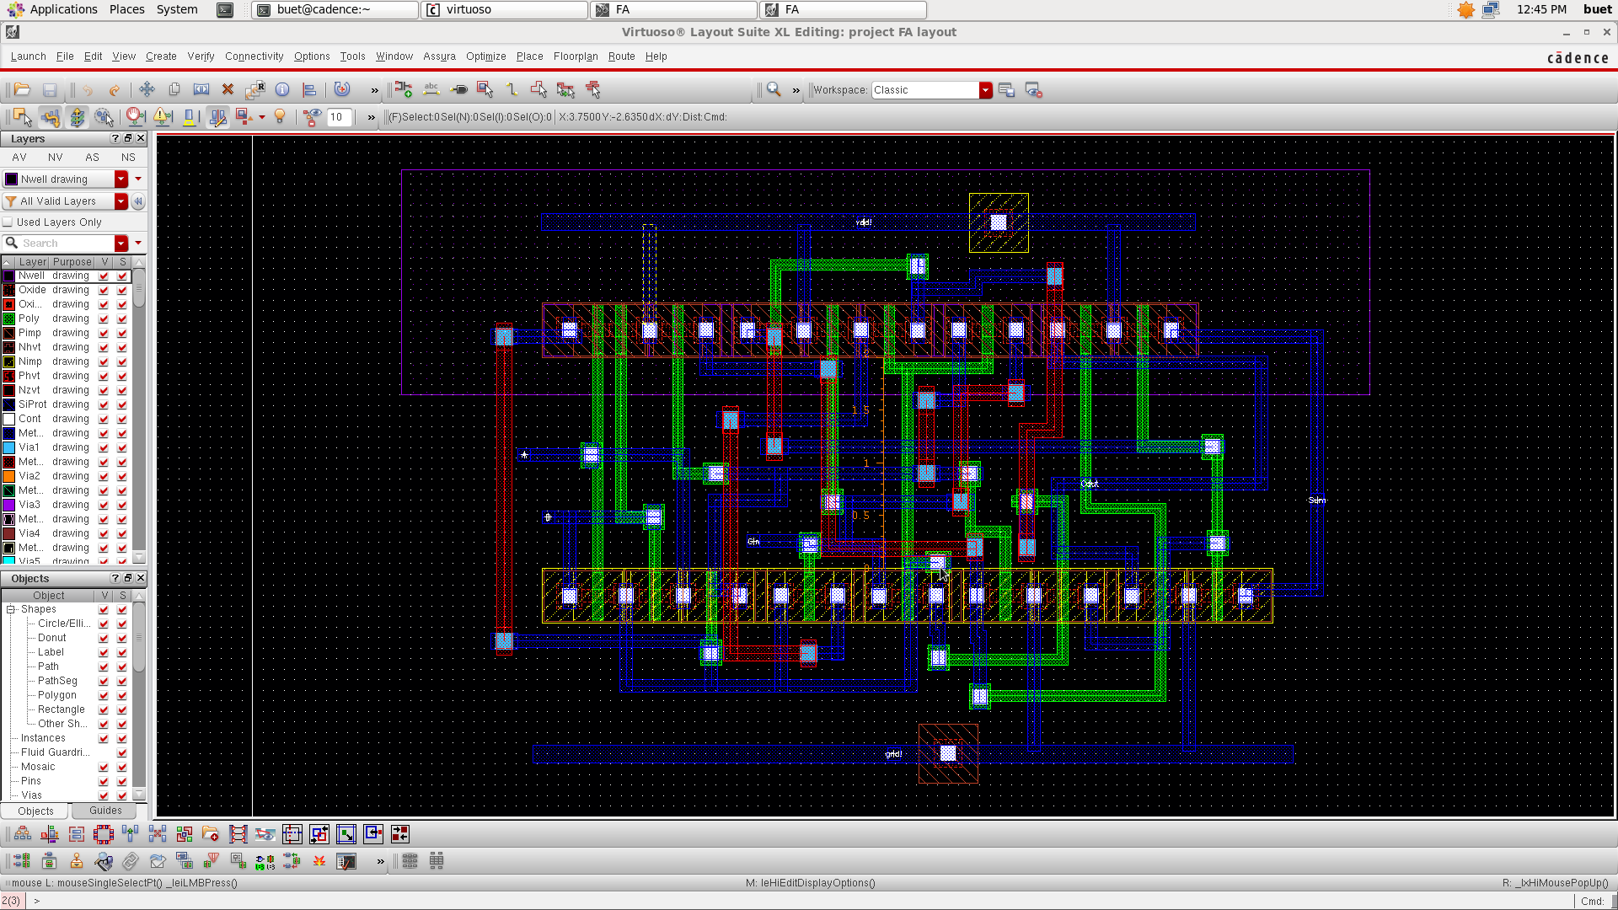
Layout diagram:

Slide 28
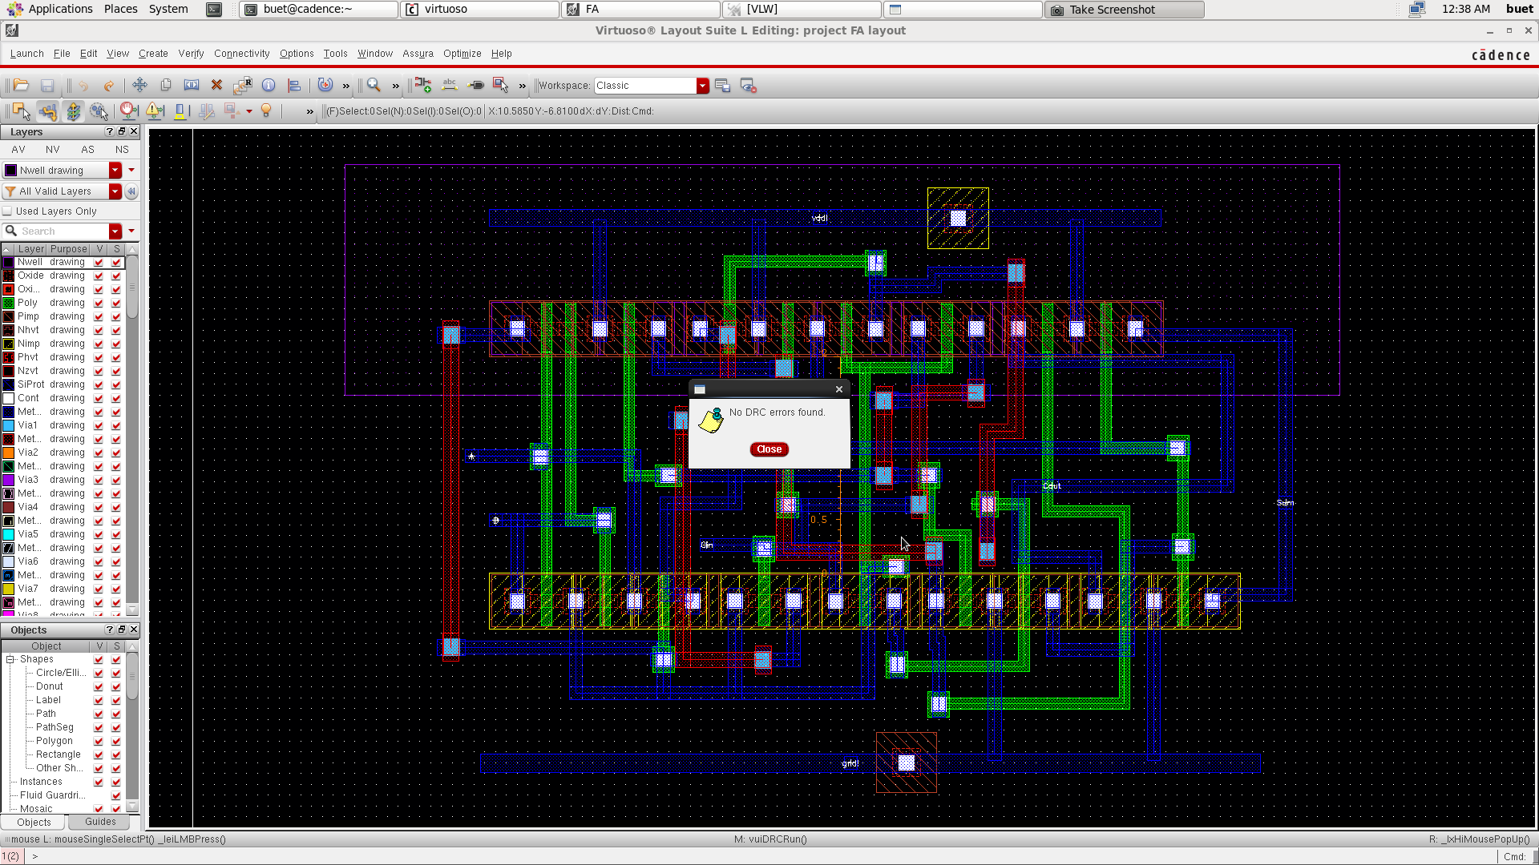
Layout diagram(no DRC error):

Slide 29
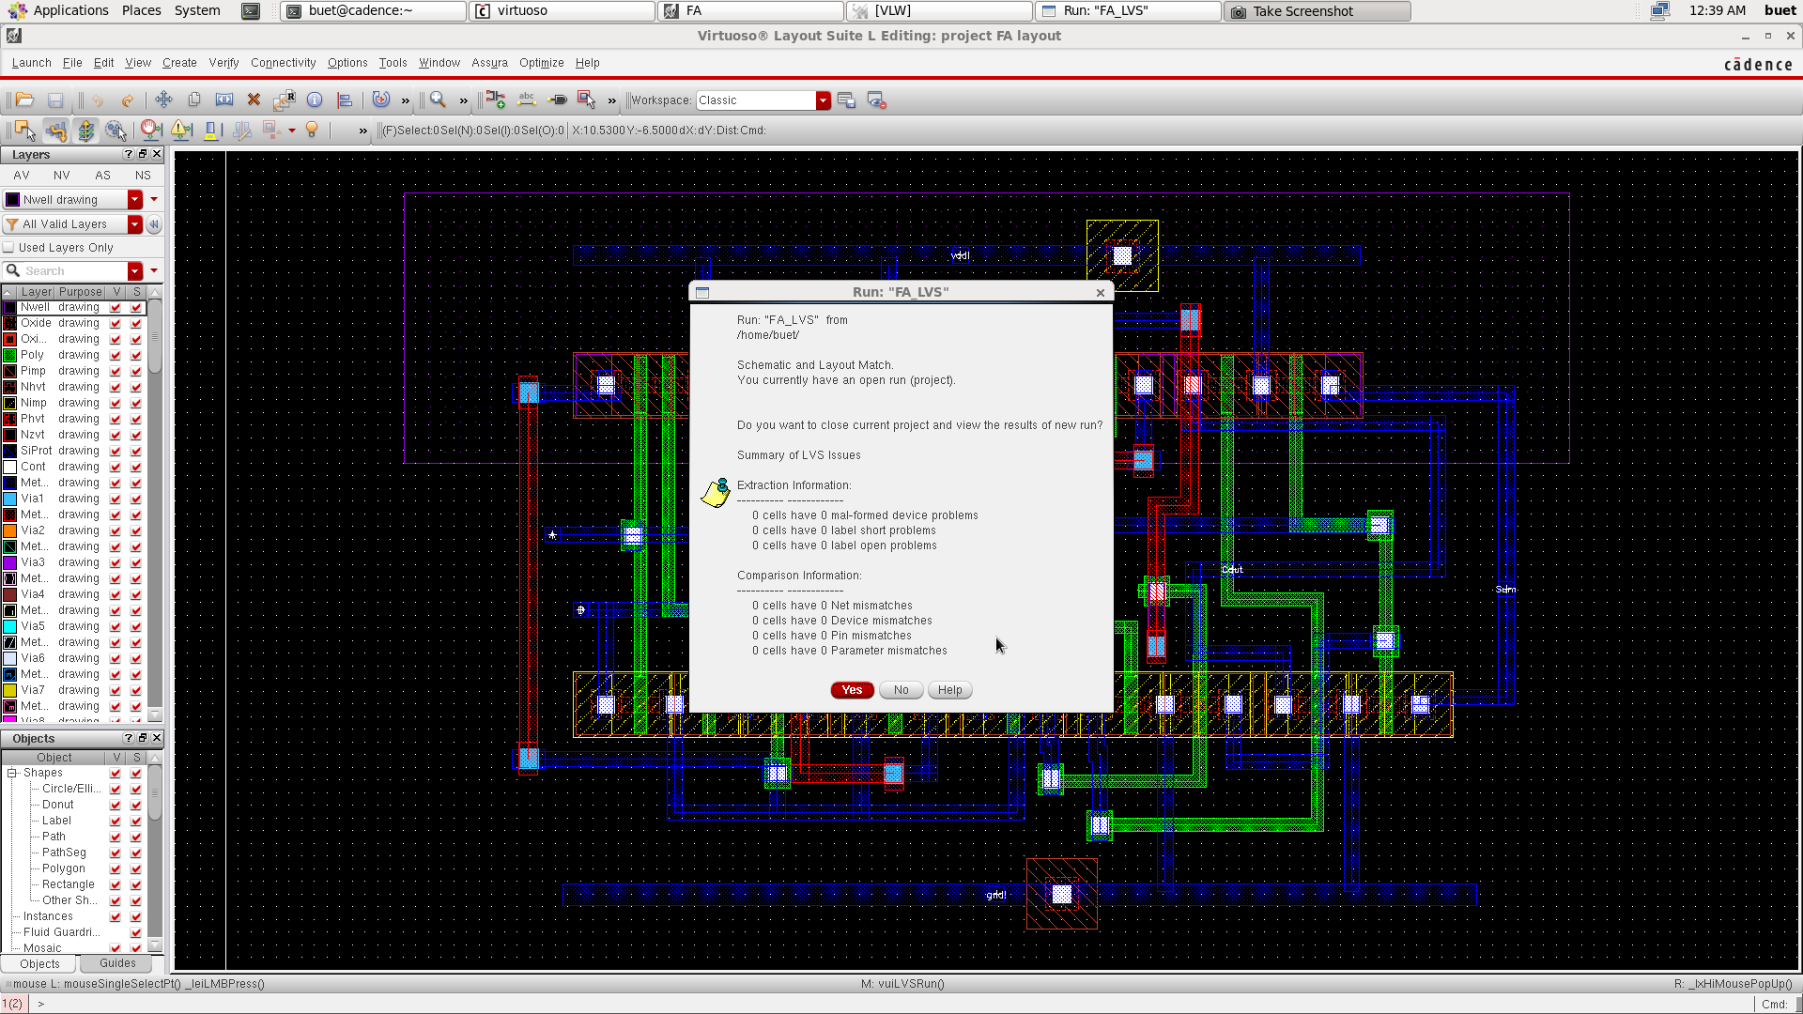
Layout diagram(no LVS error):

Slide 30
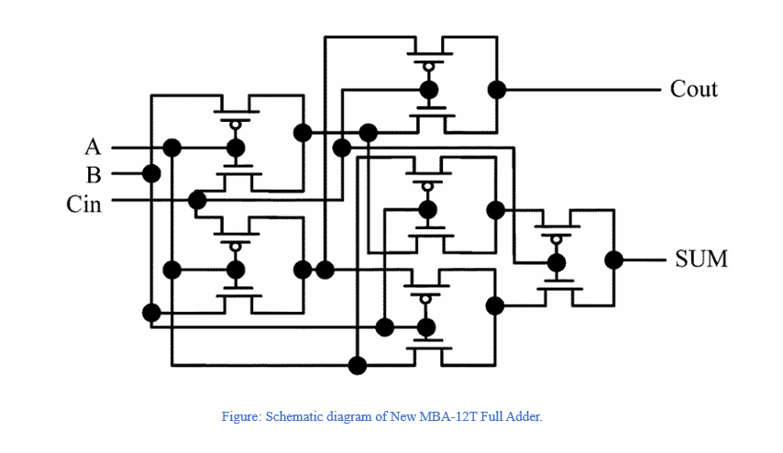
Group Member : 05
Rajemul Islam Jehan
Schematic:

Slide 31
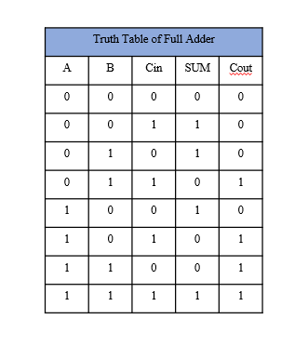
Group Member : 05
Rajemul Islam Jehan
Truth Table:

Slide 32
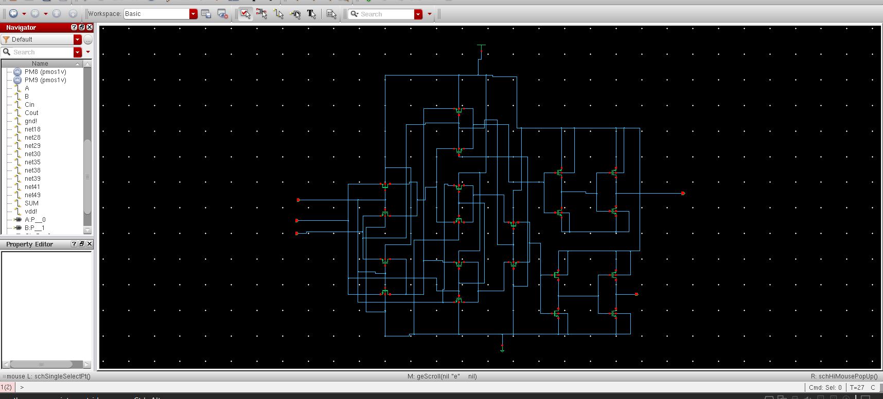
Group Member : 05
Rajemul Islam Jehan

Slide 33
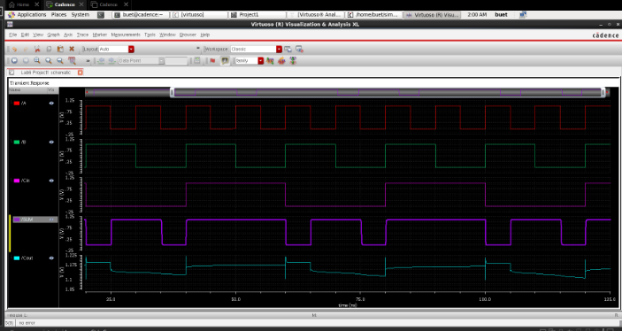
Group Member : 05
Rajemul Islam Jehan
Clock Pulse:

Slide 34
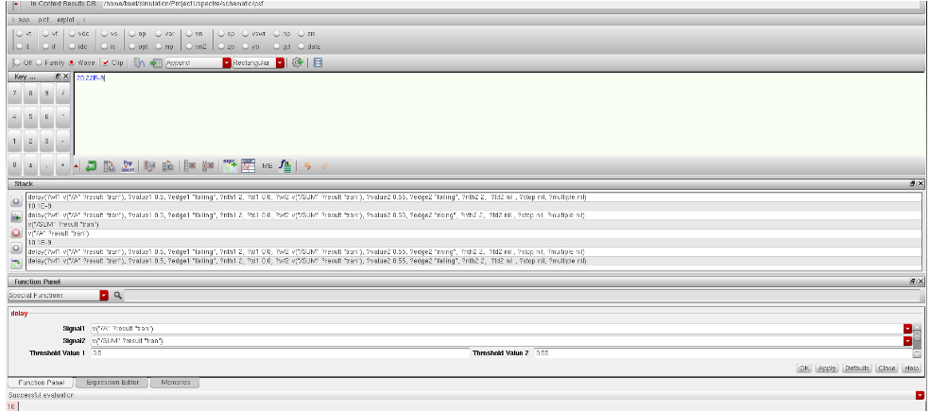
Group Member : 05
Rajemul Islam Jehan
Propagation Delay:

Slide 35
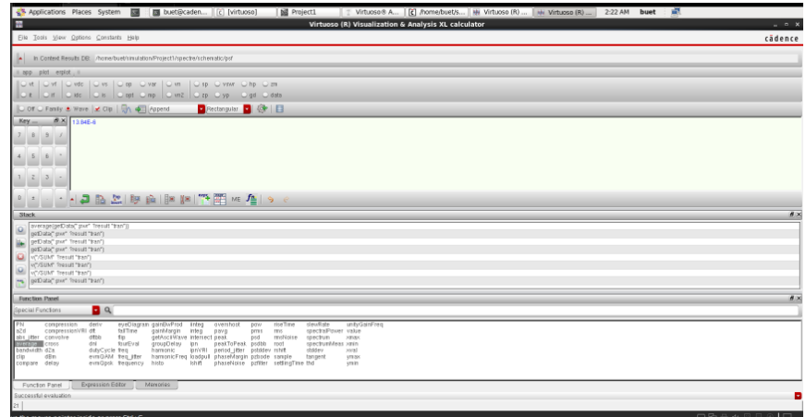
Group Member : 05
Rajemul Islam Jehan
Average Power:

Slide 36
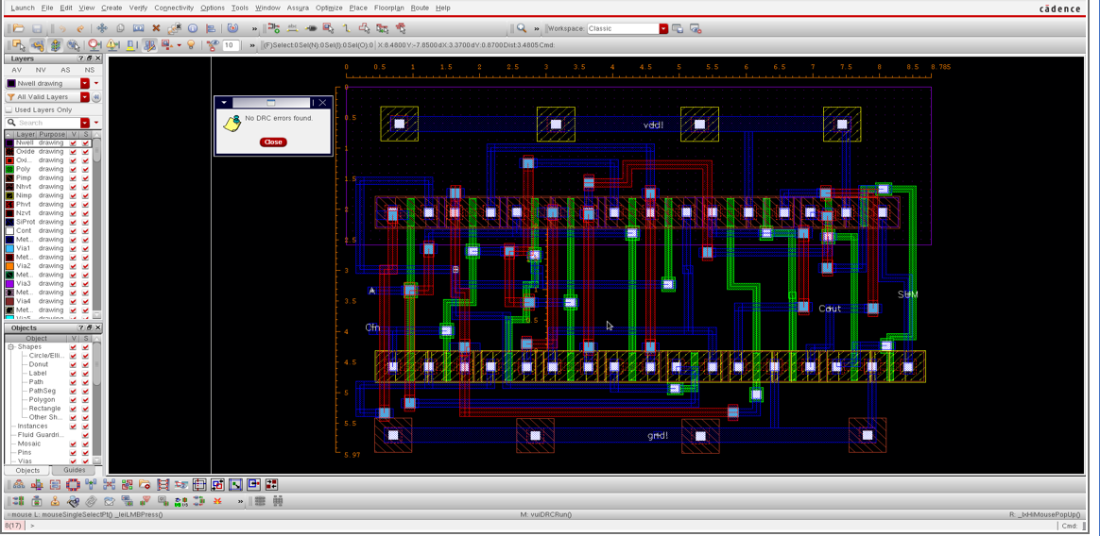
Group Member : 05
Rajemul Islam Jehan
DRC:

Slide 37
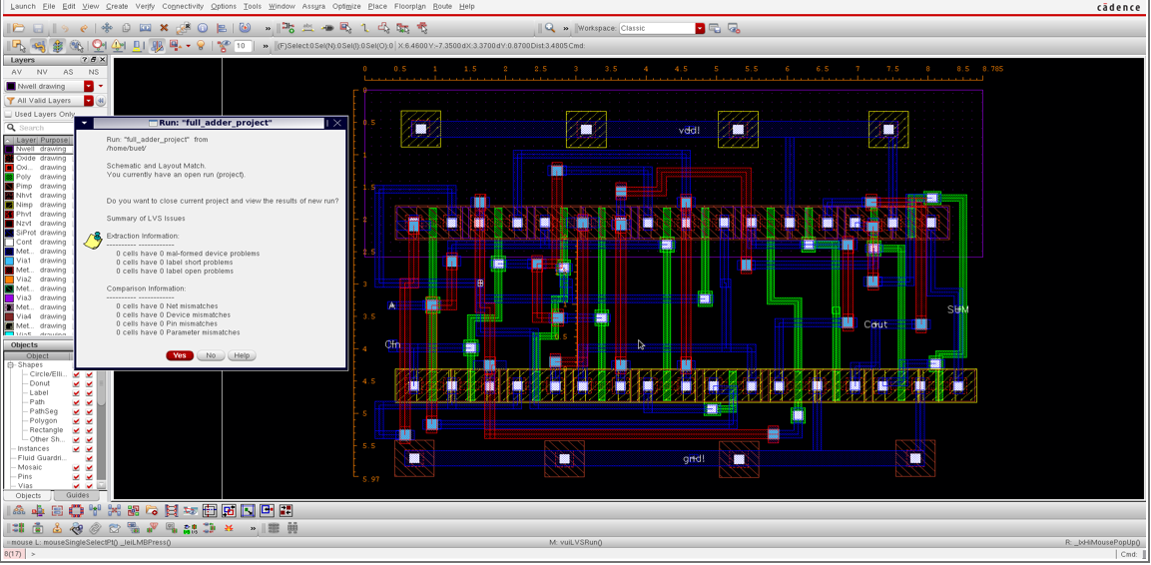
Group Member : 05
Rajemul Islam Jehan
LVS:

Slide 38
Comparison Table
Serial No. | Propagation Delay | Average Power | Power Delay Product | Cell Area | No. of Transistors | No. of DRC Errors | No. of LVS Mismatch
1
2 | 964.7 fs | 529.0 uW | 5.10E-16 Ws | 36.2404 | 10 | 0 | 0
3
4
5 | 20.22E-9 | 13.84E-6 | 2.789E-13 | 52.446E-6 | 20 | 0 | 0

Slide 39
Thank You

